Slide 1
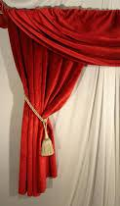
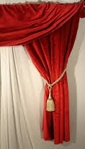

Slide 2
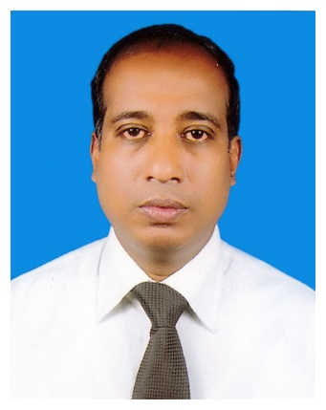
Mohammad Noor Nabi
Assistant Teacher
Urkirchar Mohammadia Gousia Sunnia Senior Madrasah
Raozan, Chittagong
Mobile – 01819-642700
E-mail – nabinishu@gmail.com

Slide 3
English
Class Eight
Time – 40 Minutes

Slide 4
1
2
3

Slide 5
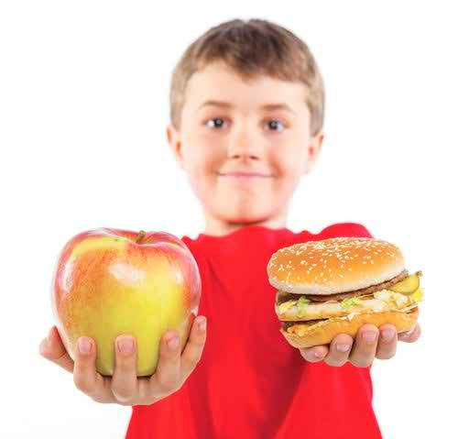
Health
Picture 1
Picture 2

Slide 6
Health and Hygiene
Unit Three
Lesson 1 : Health
Page No – 24, 25 & 26

Slide 7
Learning Out Come
By ending the lesson the student will be able-
Read and understand texts through silent reading
Listen for information
Ask and answer questions
Write the answer to questions

Slide 8
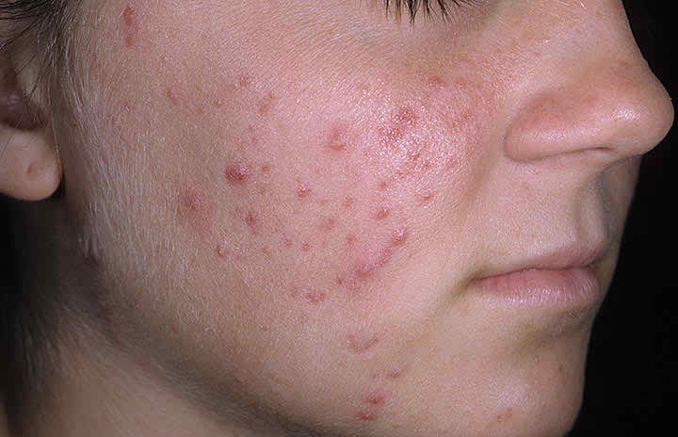
Vocabulary
Disease =
illness,
ailment,
disorder
The girl don’t free from disease

Slide 9
Vocabulary
Salma’s House
Salma achieved this possession from her father.
Property,
ownership

Slide 10
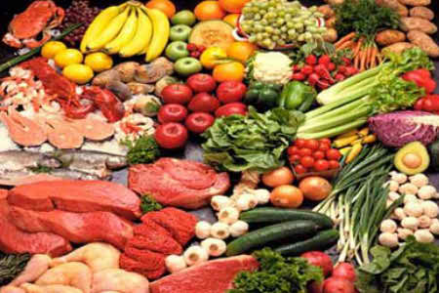
Vocabulary
Good food is essential for our body
Important
necessary

Slide 11
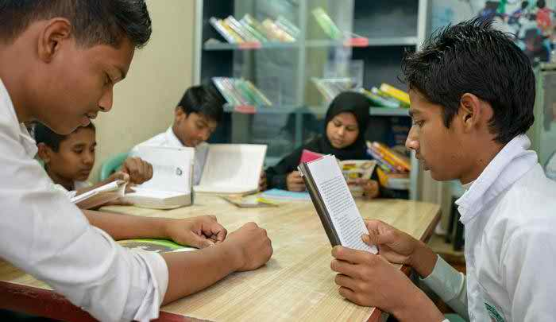
Vocabulary
We should concentrate in our study
Give attention
Condense
centralize,

Slide 12
Group Work
B. Read the text silently and answer the
questions.
Why is good health essential for us ?
Why is physical exercise necessary ?

Slide 13
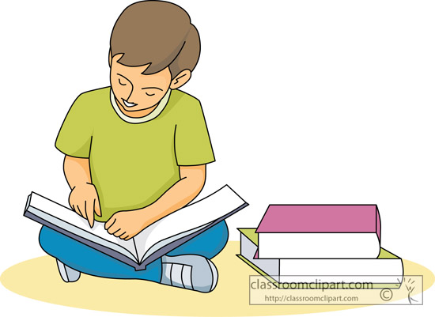
Individual Work
C. Read the text in B silently and
then choose the best answer.

Slide 14
Pair Work
E.Make five meaningful sentences using the following table
There | May have | Not only physical | Health is Wealth
Health | Being healthy | Eat a | And property
We | Is a | Vast wealth | Enjoy them
without | Have to | We can not | But also mental condition
We | is | proverb | Balanced died

Slide 15
Home Work
Write a short paragraph:
How do you maintain your personal hygiene

Slide 16
Good Bye

Slide 17
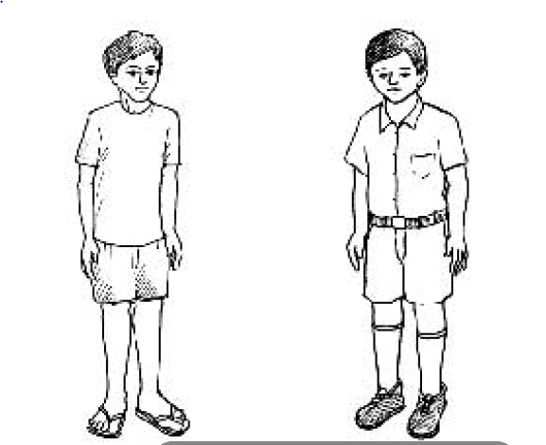
Look at and talk about the picture
A
1
2

Slide 20
Look at and talk about the picture
A
1
2

Slide 21
Look at and talk about the picture
A
1
2

Slide 22
Vocabulary
Disease
=
illness,
ail,
disorder
Essential
=
Important,
necessary,
inherent
Concentrate
=
Assemble,
centralize,
condense
Possession
=
Property,
ownership,
control
Property
=
possession,
Asset,
wealth,

Slide 23
THANKS
THANK YOU ALL

Slide 24
Group Work
D.Make five meaningful sentences using the following table
There | May have | Not only physical | Health is Wealth
Health | being | Eat a | And property
We | Is a | Vast wealth | Enjoy them
without | Have to | We can not | But also mental condition
We | is | proverb | Balanced died

